Slide 1
CH 3021:
Proton NMR spectroscopy: Basic principles
Thusitha Abeytunga

Slide 2
What is spin?
Spin is a fundamental property of nature like electrical charge or mass.
Spin comes in multiples of 1/2 and can be + or -.
Protons, electrons, and neutrons possess spin.
Individual unpaired electrons, protons, and neutrons each possesses a spin of 1/2.

Slide 3
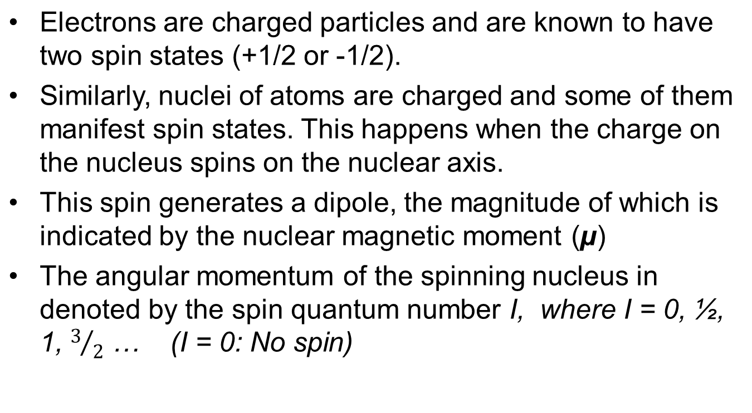

Magnetic dipole created by the spin of a charged particle.

Slide 4
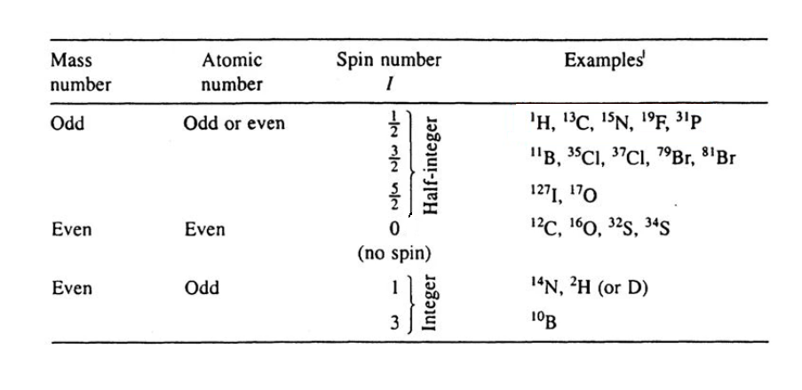
NMR active nuclei
The spin number (I) is determined by the number of protons and neutrons present in the nuclei (specifically whether there are odd or even number of each particle).

Slide 5
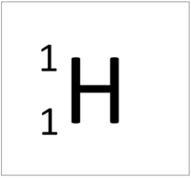
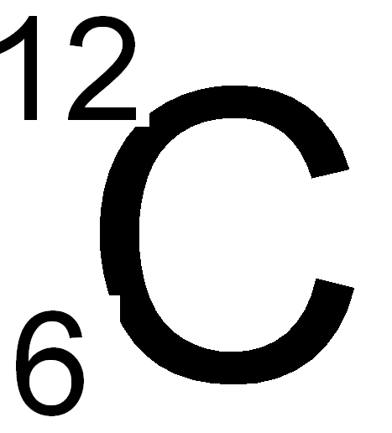
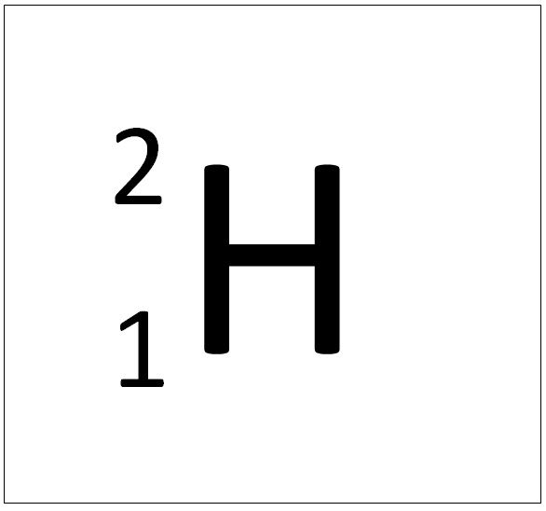
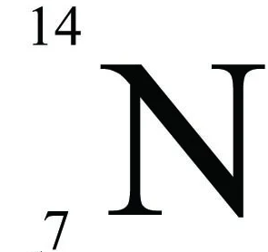
Examples
I=1/2
Spherical charge distribution
I=1
Non spherical charge distribution

Slide 6
Nuclei having spin of 0
¹²C
¹⁶O
³²S
No NMR signal

Slide 7
Use of NMR active nuclei in practice
Any nuclei with a non-zero spin number is in principle NMR active.
However, nuclei with I = ½ give the best spectra due to uniform spherical charge distribution
Nuclei with I ≥1 have a non-spherical charge distribution. This is described as an electrical quadrupole moment. This has a direct impact on the NMR spectra obtained with these nuclei.
Other factors such as natural abundance are important factors determine the usefulness of a nuclei for characterization

Slide 8
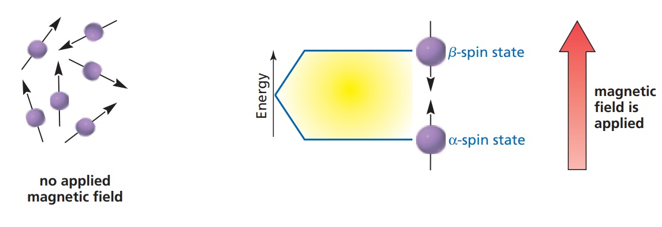
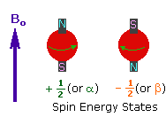
Spin states
Number of accessible spin energy levels (spin states) can be calculated by the equation 2 I +1. Hence, protons (I =1/2) will have two levels α and β.
When a magnetic field is applied these spin levels are separated with the nuclei in the state that is aligned with the magnetic field (α) occupying the lower energy level.
ΔE
B₀

Slide 9

Different explanation in the next 2 slides: The proton possesses a property called spin which
can be thought of as a small magnetic field
will cause the nucleus to produce an NMR signal

Slide 10




How particles with spin behave in a magnetic field
Think of the spin of a proton as a magnetic moment vector
As a tiny magnet with a north and south pole

Slide 11
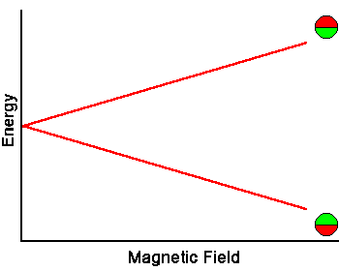

Slide 12
Boltzmann Statistics
At room temperature, the number of spins in the lower energy level, N+, slightly outnumbers the number in the upper level, N-.
Boltzmann statistics tells us that
N-/N+ = e^{-E/kT}.
E is the energy difference between the spin states; k is Boltzmann's constant, 1.3805x10-23 J/Kelvin; and T is the temperature in Kelvin.
As the temperature decreases, so does the ratio N- /N+. As the temperature increases, the ratio approaches one.

Slide 13
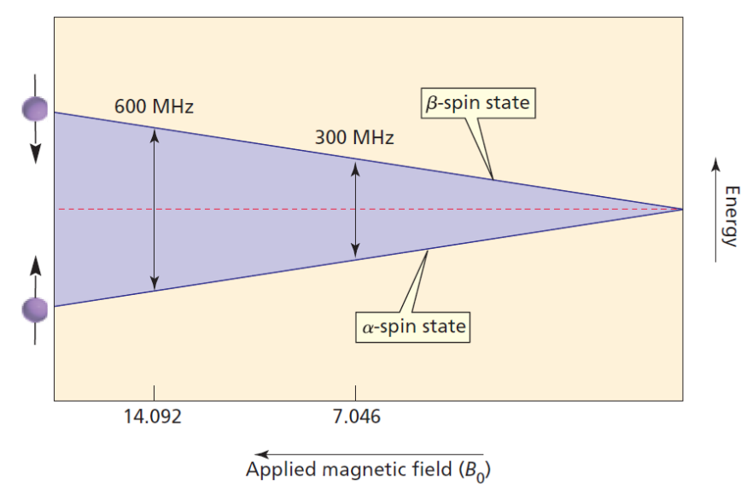
Radio frequency transitions
Transitions require radio frequency (RF) radiation.
The energy gap between spin states widen with increasing magnetic field strength.
According to the Boltzmann distribution the α state (lower energy) will have a slightly higher population that the β state (higher energy) state.
ΔE

Slide 14
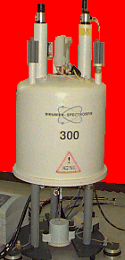

Slide 15
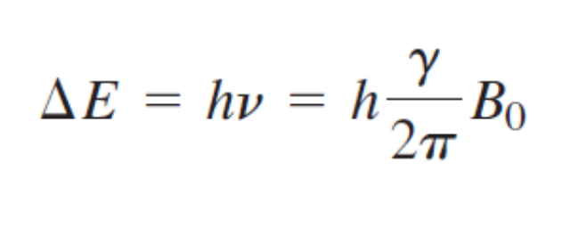
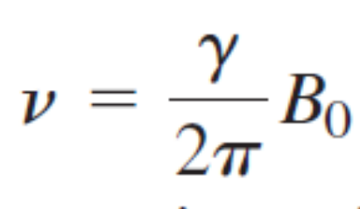
Energetics of NMR transitions
The energy difference between these levels (ΔE) is given by the following equation:
h = Planck constant
ν = Frequency
γ = Gyromagnetic ratio (nuclei specific constant)
B₀ = Strength of applied magnetic field

Slide 16
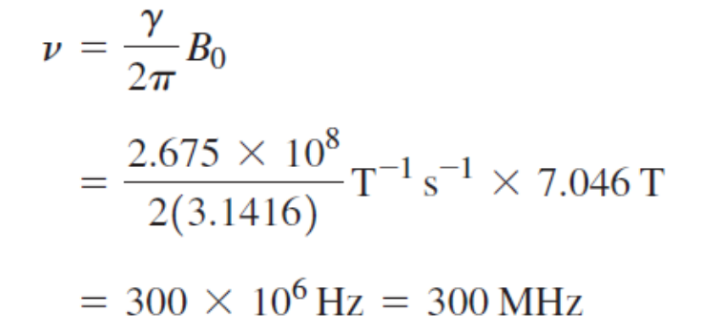
Sample calculation
A ¹H NMR spectrometer is equipped with a magnet that produces a 7.046 T field. If the gyromagnetic ratio of a ¹H is 2.675 x 10⁸ T⁻¹s⁻¹. Calculate the frequency of the radiation required.

Slide 17
Larmor frequency
In NMR, the quantity ν is called the resonance frequency and the Larmor frequency.

Slide 18

Application of radio frequency
In NMR spectroscopy, radio frequency can be applied to nuclei using one of two different techniques
- Continuous wave scanning (CW)
- Pulsed radio frequency
In order to explain these methods, we will use a classical spinning top model that describes the behavior of a proton in an external magnetic field
This model is very important in understanding how the spin phenomenon is used to obtain a spectrum

Slide 19
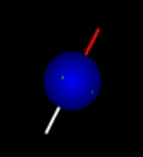
Spinning top model of NMR spectroscopy
The application of radiofrequency (rf) radiation to protons aligned in a stationary magnetic field and the measurement of energy absorbed can be explained using this model.

Slide 20
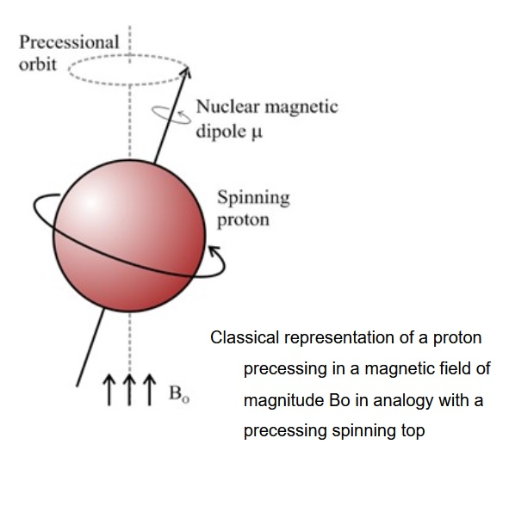
Precessing protons in a magnetic field
When a magnetic field is applied to protons, they will attempt to align either with or against the applied magnetic field to occupy either the α or β state.
As the protons attempt to maintain the alignment, they will precess around the axis that is in the direction of the applied magnetic field.
This is defined as the z axis. The precessional frequency is known as Larmor frequency

Slide 21
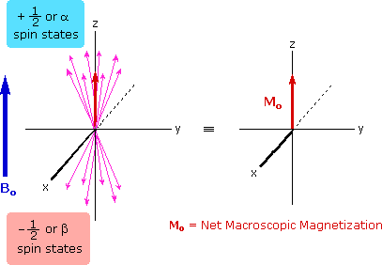
Net magnetization
As individual protons attempt to align and precess. The assembly will create a macroscopic magnetization know as the net magnetization (M₀) along the z-axis
Remember the α state has a higher population here

Slide 22
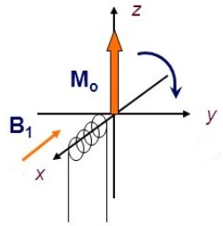
Nuclear Magnetic Resonance
Now a radiofrequency (v₁) equal to the Larmor frequency of equivalent protons is applied. When this occurs those equivalent protons are said to be in a state of nuclear magnetic resonance.
In our model this will cause the net magnetization to tip on to the xy plane. this magnetization can be used to create a weak electric current that can be detected and used to obtain a spectrum.
To accomplish this a rf oscillator coil is positioned perpendicular to B₀.(conventionally along either x or y axis)
As the rf wave is applied a magnetic component B₁ is generated (electromagnetic field of rf waves)
This oscillating magnetic field B₁ is what is responsible for tipping the net magnetization on to the xy plane.

Slide 23
Continuous wave (CW) spectroscopy
An important thing to remember is that protons in different chemical environments will have different Larmor frequencies.
Hence a frequency range will be “scanned” and each kind of proton will be brought to resonance one by one.
This is how the spectrum is obtained.
Many early NMR spectrometers functioned using this continuous wave (CW) method.
However, most modern spectrometers use a technique knows as pulsed Fourier transform spectrometry to record a spectrum (will be discussed later)

Slide 24
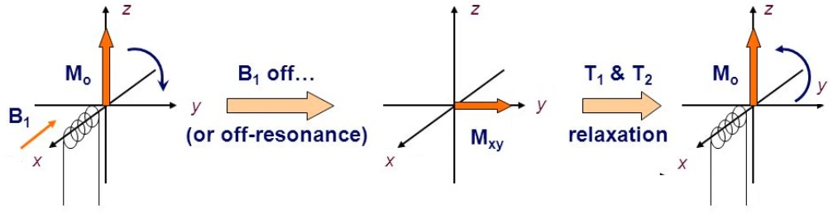
Relaxation
Relaxation is the process by excited nuclei return to their equilibrium state.
There are two main relaxation processes:
1. Spin-lattice or longitudinal relaxation (T₁ relaxation)
2. Spin-spin relaxation (T₂ relaxation)

Slide 25
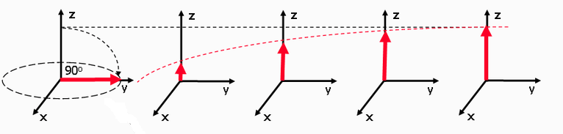
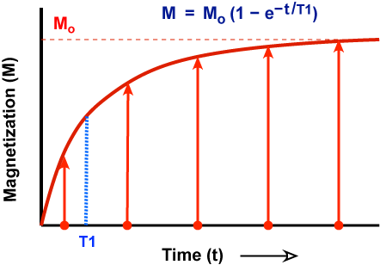
Spin-Lattice relaxation
Known as longitudinal relaxation or T₁ relaxation.
Transfer of energy from “excited” protons to the surrounding molecules or the “lattice”
The results in the restoration of the net magnetization M₀ along the z-axis
T₁ is the time taken to restore the net magnetization (M or M_{z} here) to (1-1/e) or 63% percent of the original value (M₀) (i.e. when t = T₁)
Value of e = 2.718

Slide 26
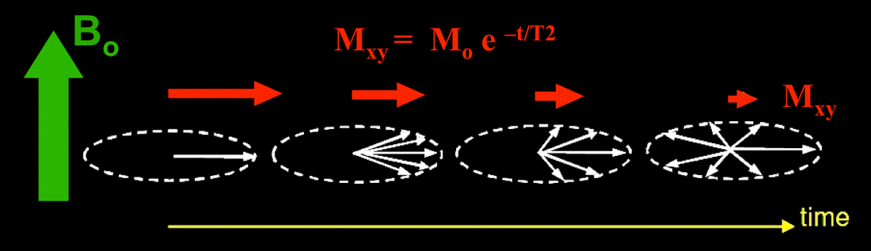
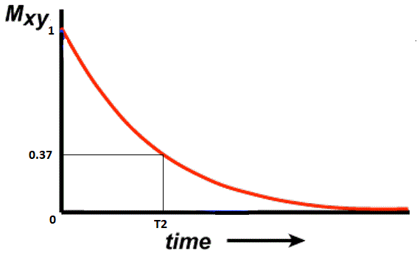
Spin-spin relaxation
Also known as transverse relaxation or T₂ relaxation.
Transfer of energy among precessing protons
The results in the decay/dephasing of the transverse component of the net magnetization (M_{xy}) which is on the xy-plane
T₂ is the time taken to decay the magnetization in the xy plane (M_{xy}) to (1/e) or 37% percent of the original value (M₀) (i.e. when t = T₂)

Slide 27
Comparison of T₁ and T₂ relaxation
T₁ relaxation | T₂ relaxation
Transfer of energy from nuclei to the surroundings | Energy transfer between nuclei
Longitudinal | Transverse
Relatively slow | Relatively fast
Re-establishes the equilibrium Boltzmann distribution | Causes decay and dephasing of excited transverse magnetization

Slide 28
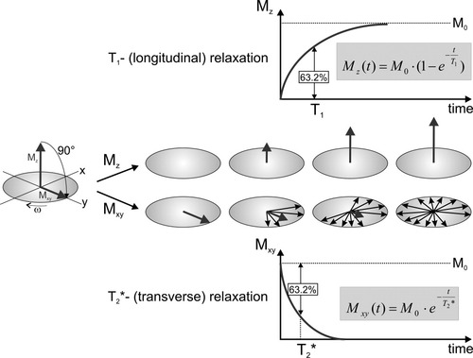
Summary of relaxation of processes

Slide 29
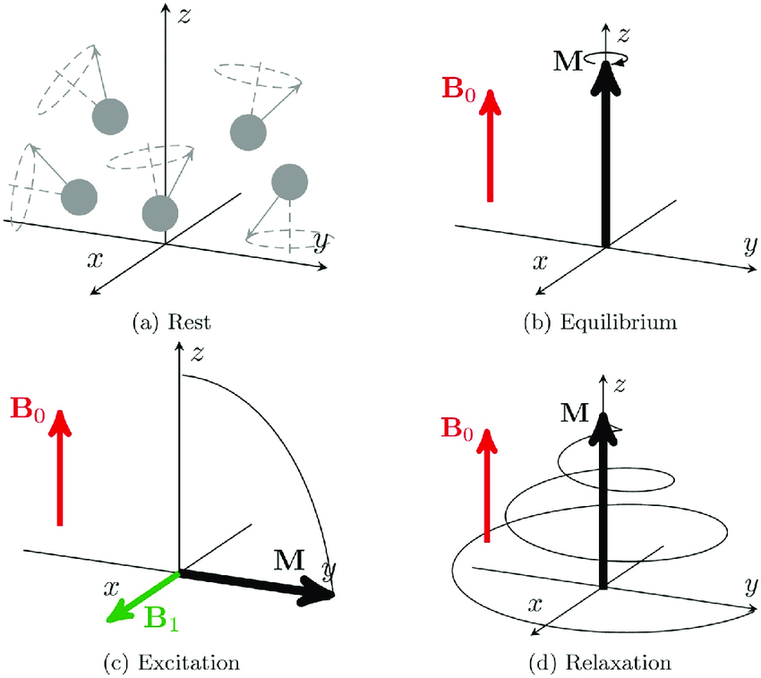
Summary of basic NMR process
a.) Sample at rest. Protons have no net magnetization
b.) An external magnetic field applied (B₀) and the protons generate a net magnetization (M₀ or M in this figure)
c.) Excitation is carried out with a oscillating rf wave which has a perpendicular magnetic field B₁ . This causes the M₀ to tip on to the XY plane
d.) Rf wave is removed resulting in T₁ and T₂ relaxation and equilibrium is restored

